Slide 1
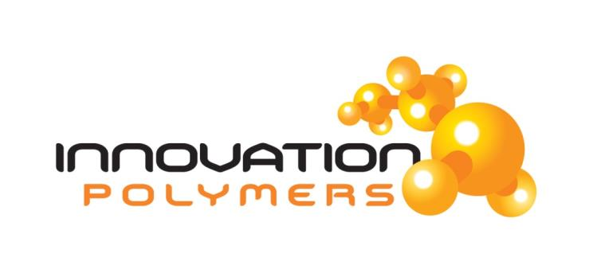
ACOUSTIC COUPLING MEDIUM
Solutions Through Innovation
January 2016

Slide 2
PRESENTED MATERIAL
This presentation works to convey new innovative ideas and makes statements pertaining to specific applications that benefit from effective sound transfer for superior insonification.
Our product line is a reflection of the NDT and medical ultrasound sectors pushing to have novel solutions to inspection and to mimic materials for diagnostic/phantoms.
Industry feedback and collaboration are the principles that drive and motivate the Innovation Polymer development activity.

Slide 3
INNOVATION POLYMERS’ CONTRIBUTION;
ULTRASONIC COUPLING OF SOUND
Products that enable more effective sound transfer:
  Wheel probes
  Wedge shapes, normal beam and angle beam, long & shear
  Other forms; delayline, tube, ID or OD and even lenses
Barrier options to capture/contain:
  Water column diaphragm
  Water or couplant bladder
  Water balloon
Novel coupling options enable long term maintenance- free monitoring solutions:
  Bond-to-component pads (dry coupling or couplant media)
Combining NDT disciplines affords greater potential:
  Eddy Current & ultrasonic sensors integrated in a carrier

Slide 4
COLLABORATION AND KNOWLEDGE EXCHANGE
Our focus is on highly effective sound transfer through the development of acoustic-capable polymers. These new polymers enable coupling of the ultrasonic sensor to the material under test or provides a layer to couple, seal or optimize energy transfer.
Industrial dry coupling applications
Novel wheel probe or delay line
Sensor covers or optimizing layers
Medical phantom
Sensitivity and resolution targets

Slide 5
TOGETHER WE CAN FIND SOLUTIONS
WE NEED YOUR IDEAS !
WHAT IS YOUR PROBLEM APPLICATION !
Modify or create new innovative coupling media
Impedance matching for plastics and tissue
Optimize beam with coupling material lens
Contain water or other unique coupling
Accommodate changing part geometry
Combine sensors in coupling media
Optimize refraction characteristics
Enable unique carrier delivery
What else?

Slide 6
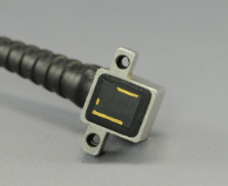
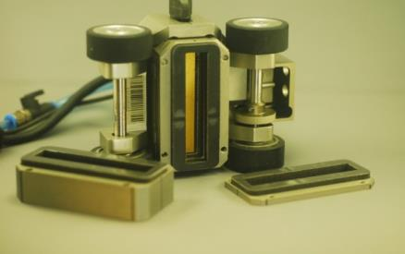
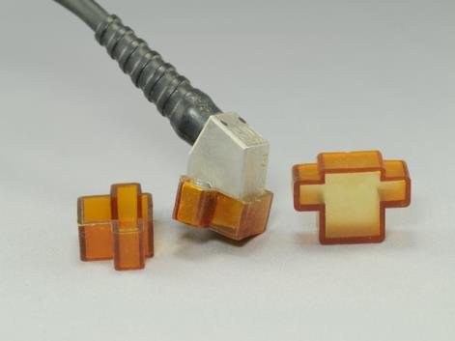
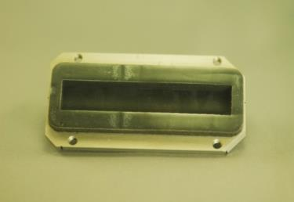
CREATE OR MODIFY
Prevent damage
Enhance performance
Phased Array coupling & protective covers
Olympus HydroForm modified to chamber water column

Slide 7
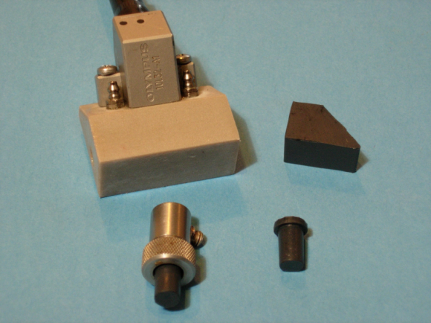
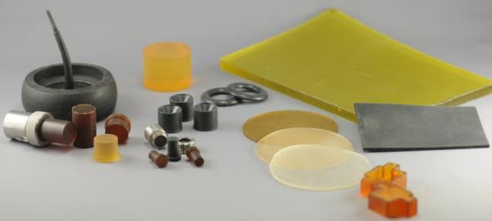
ANY SHAPE
Match material property
Sheet or any shape
Wedge (SLS case) with ACE™ insert
Delayline
ACE™ & Aqualene™
Aqualink™
Now Innovation Polymers also works with Silicon and Polyurethanes

Slide 8
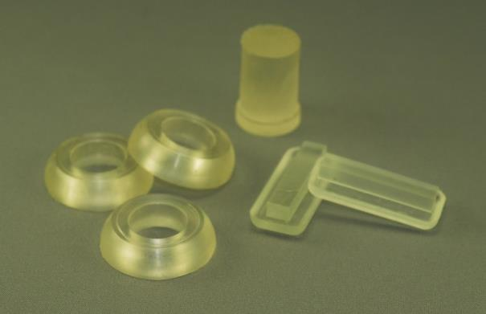
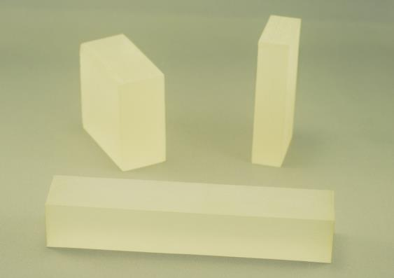
MORE SHAPES
COMPLEX OR SIMPLE BLOCK
Specific application
Water equivalent
Beam optimizing with lens or covers
Phased array and conventional

Slide 9
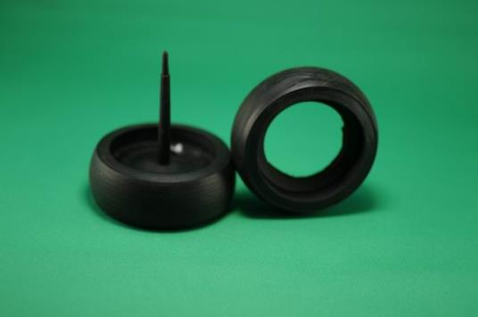
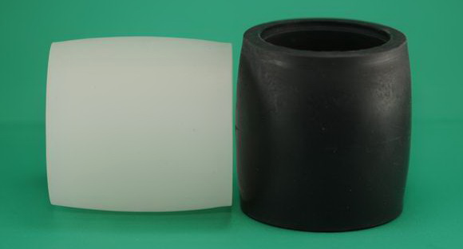
WHEEL – PHASED ARRAY, CONVENTIONAL AND TOFD
Area scanning options
Any shape – size
Wheel Phased Array
Novel wheel designs

Slide 10
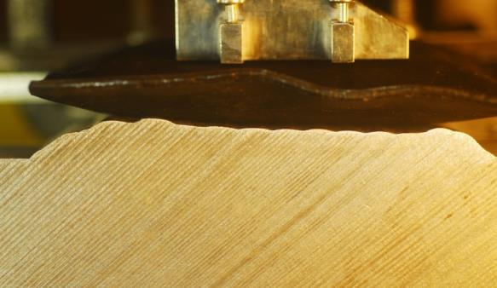
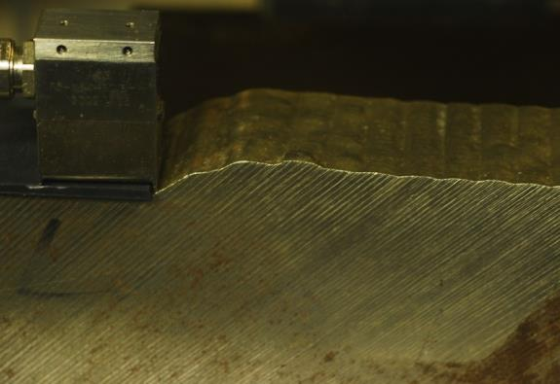
OVER WELD INSPECTION OR PIPE BALLOON
Ideal for dissimilar welds
Adjacent to weld scans
Over weld bladder complies with cap
Pad for contact array for FMC/TFM

Slide 11
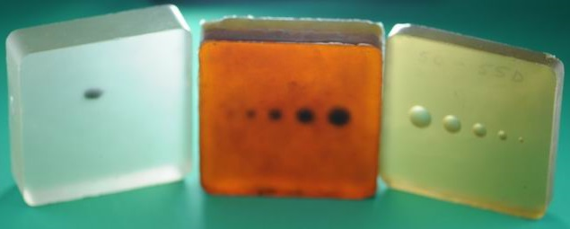
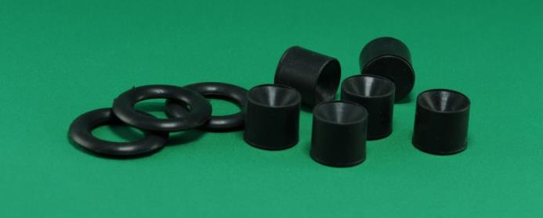
LENS AND NOVEL APPLICATION
Targets & cavity shapes
Manipulate beam
Combine material or embed targets
Lens to disperse or focus beams

Slide 12
OLD INSPECTION PROBLEMS
NEW POTENTIAL SOLUTIONS
Improved coupling of our ultrasonic sensors is part of the complex mix of actions to be considered for improved inspection.
Consideration for alternative means to inject sound into the part is now yielding options to ultrasonic squirter inspection and bubbler approaches.
These new enhanced materials offer tuned matching of the coupling layer at the component interface and provide enhanced performance which can be implemented for production applications, fully automated, semi-automated and manual inspection.
Combining the many new mechanical delivery systems with the instrumentation and software means we must review how we script our procedures and techniques to be inclusive of details for sound coupling.

Slide 13
REVISIT THOSE HISTORIC PROBLEMATIC INSPECTION APPLICATIONS
HDPE pipe fusion welds
  novel properties demand new approach
TOFD for polyethylene products
  effective refracted angles in polyurethanes
Girth weld & welds in general
  unique materials again
High temperature
  Silicon wheel and polymer wedge assemblies
Rail and high production
  Polyurethane with complex sensor assemblies
Data fusion (ET & UT & RT & VT)
  how it will impact our future

Slide 14
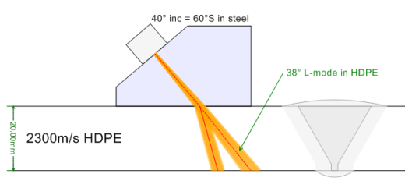
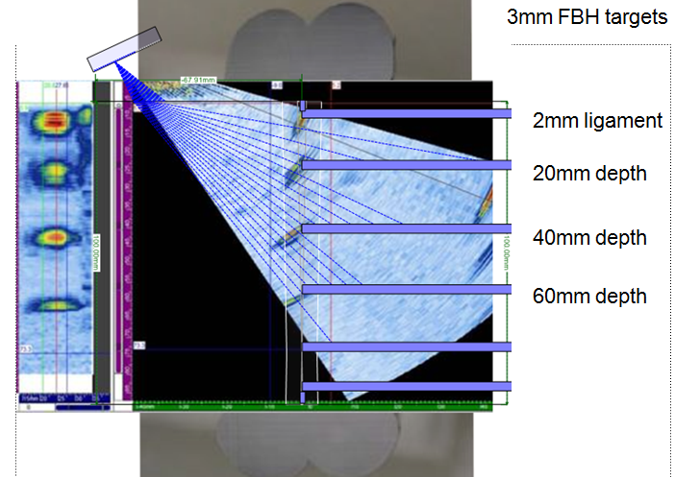

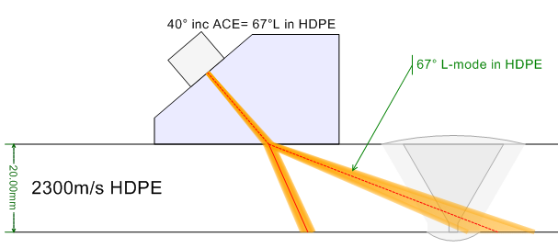
HDPE BUTT FUSION WELD INSPECTION
Phased Array or Conventional Wedge Designs
Poor Refracting Angle
Rexolite wedge
Good Refracting Angle
ACE™ wedge

Slide 15
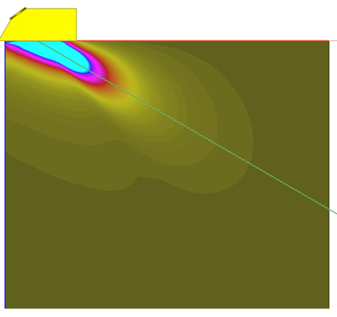
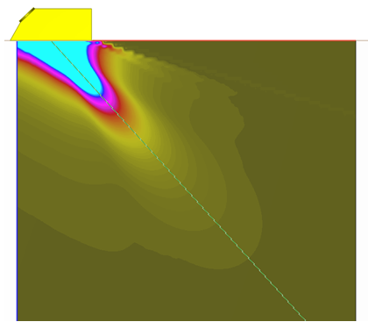
TOFD FOR POLYETHYLENE INSPECTION
Rexolite 43° incidence on left
ACE™ 35.4° incidence on right.
Using low velocity wedge material such as ACE™ provides a good velocity ratio resulting in less beam distortion. The higher refracted beams can be generated with lower incident angles. 35.4° incidence produces a 60° refracted angle in HDPE (Vel. 2330m/s) and a useful lateral wave can be obtained even with a 5MHz probe.
Notes:
ACE at about 1600m/s and use the same incident angle (actually 40.5°) we get 67° L-mode
OK for TOFD (as long as the HDPE was +/- about 100m/s from 2300m/s)

Slide 16
GIRTH WELD – OVER WELD FMC/TFM
Traditional zonal approach can be enhanced
  Add over weld techniques (chambered water column)
  Add FMC/TFM to refine visualization
  Add Eddy Current Array for surface/near surface
  Apply SAFT and other DSP to further refine sizing
Accuracy and geometry awareness is critical
  Utilize FMC/TFM to enable wall thickness validation
  Utilize TFM to measure velocity (wedge/part)
  Utilize TFM to measure & accommodate temperature
Speed is now enhanced with faster instrumentation and dedicated processing
  Excitelet - Extension of the Total Focusing Method (TFM)
Notes:
Effects of Dissimilar welds – lined pipe need to be considered now
Excitelet – new – next generation FMC TFM ------ Extension of the Total Focusing Method (TFM)

Slide 17
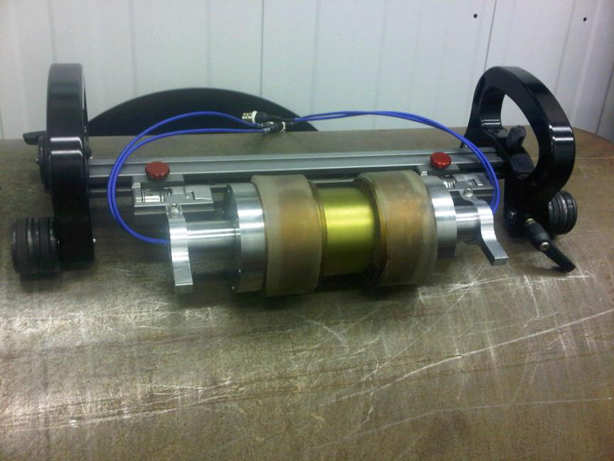
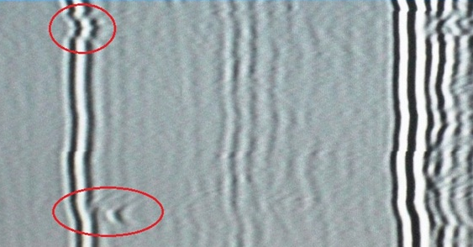
WHEEL TOFD - QSEE
Fast and minimal additional wetting required

Slide 18
RAIL INSPECTION
Low speed and high speed applications demand specific tire materials and unique coupling ability (minimal wetting).
The wide range of operating temperatures requires unique polymer properties to ensure optimized performance.
Optimized Polyurethane tire design ensures effective sound entry and optimal beam coverage.
Harsh field conditions demand materials that are cost effective with the potential of healing liners and other innovative approaches to limit down time.

Slide 19
HIGH TEMPERATURE
Wheel and novel polymer wedge materials can enable safe ultrasonic inspection to 350°C with 100% inspection duty cycle.
Silicon based tire designs and integrated cooling systems enhance inspection capability.
Embedded in the polymer carrier the thermocouple along with software capability to interpret and correct for temperature effects on attenuation and velocity are now all viable options for effective high temperature inspection.
Effective visualization and monitoring enables operators to interpret and report with confidence.

Slide 20
DATA FUSION – UT & ET
In an ideal world we would combine the strengths of inspection disciplines
Now we can improve visualization of surface and volume using novel carrier options for eddy current array and phased array technology
ACE™ ultrasonic wheel probe technology can now have coils included in the design as one more unique approach to inspections
Time to rethink how we perform inspection and how we visualize the data
Time to advance systems to provide more and better information to the technician
3D – 4D visualization will make it easy to interpret combined data

Slide 21
WHO WE ARE
The key founders of the company have the experience and dedication needed for the advancement of sound transfer technology.
With over 35 years of rubber molding and production experience, Rick MacNeil knows how it’s done.
The ultrasonic side is managed by Robert Ginzel and Edward Ginzel, who contribute over 80 years of combined NDT knowledge, specializing in advanced ultrasonic applications.
We have the facility and capability to develop a wide range of unique sound coupling media.

Slide 22
LET’S DISCUSS THE PROBLEM
LET’S SOLVE THE PROBLEM
THANK YOU FOR YOUR ATTENTION
Contact us:
Rick MacNeil P.Eng.
Operations Manager
Robert Ginzel
Sound Research

